Slide 1

Right-Sizing Influenza A Genomic Surveillance: Evaluating Subclade Detection Capacity Across African Countries (2023–2024)
Dikeledi Kekana
Centre for Respiratory Diseases and Meningitis,
National Institute for Communicable Diseases,
A division of the National Health Laboratory Service

Slide 2
Introduction
Effective genomic surveillance of influenza viruses is essential for early detection of emerging variants and informing vaccine composition.
The concept of right-sizing provides a framework for determining the minimum number and distribution of samples required to reliably capture circulating viral diversity and detect low-prevalence variants with high confidence.
This study evaluates the current genomic sampling efforts in five African countries using publicly available sequence data to inform right-sized, resource-efficient surveillance approaches.

Slide 3
Objectives
To characterise of influenza virus lineages and clades circulating in South Africa, Zambia, Madagascar, Mauritius, Ghana, and Kenya using publicly available genomic data.
To evaluate the genetic diversity and phylogenetic relationships of influenza viruses in the region
Estimated the optimal number of sequences needed per country and per season to achieve sufficient detection power and lineage coverage

Slide 4
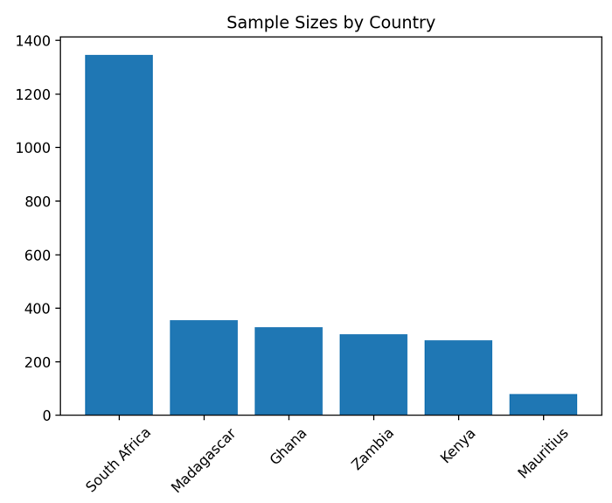
Data Overview
Influenza virus genomic sequences and associated metadata were retrieved from the GISAID EpiFlu™ database for six African countries: • South Africa (1,347) • Madagascar (355) • Zambia (302) • Kenya (281) • Ghana (329) • Mauritius (79)
Working on receiving samples from Namibia, South Sudan, Mauritius
H1N1pdm09
936 sequences
H3N2
1,152 sequences
B/Victoria
604 sequences
Data were filtered to include seasonal influenza A and B viruses collected between 2023 and 2024:

Slide 5
Methodology
Clade/Lineage assigned
Nextclade
Visualisation
Python
Phylogenetic analysis
Nextstrain

Slide 6
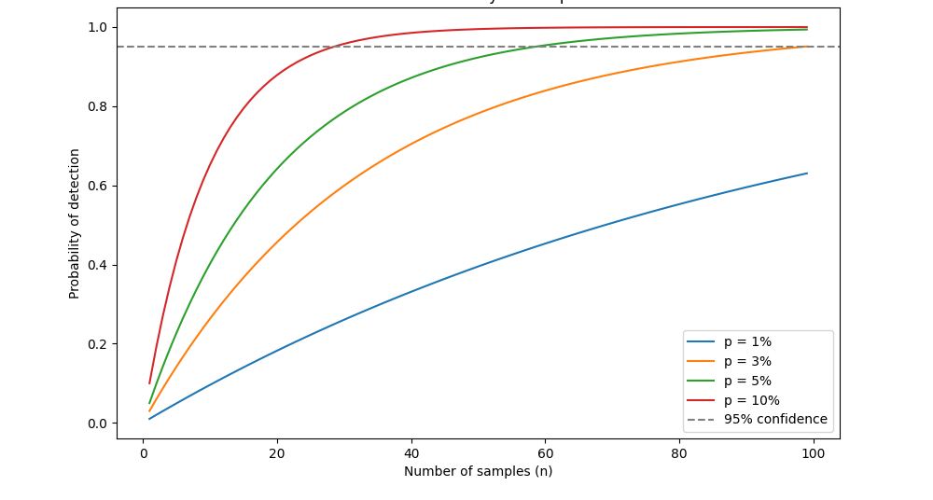
Methodology
Binomial probability model
To evaluate whether current sampling is sufficient to detect emerging variants at low prevalence, a binomial probability model was used. Where p is the assumed prevalence of the variant (5%) and n is the number of sequences generated per month or season
Question: If a subclade was circulating at 5% prevalence, would we be able to detect with our current sequencing efforts?
A binomial probability model is a statistical model that calculates the probability of achieving a specific number of successes in a fixed number of independent trials, where each trial has only two possible outcomes (success or failure).
Notes:
To evaluate whether current sampling is sufficient to detect emerging variants at low prevalence, a binomial probability model was used. Where p is the assumed prevalence of the variant (5%) and n is the number of sequences generated per month or season

Slide 7
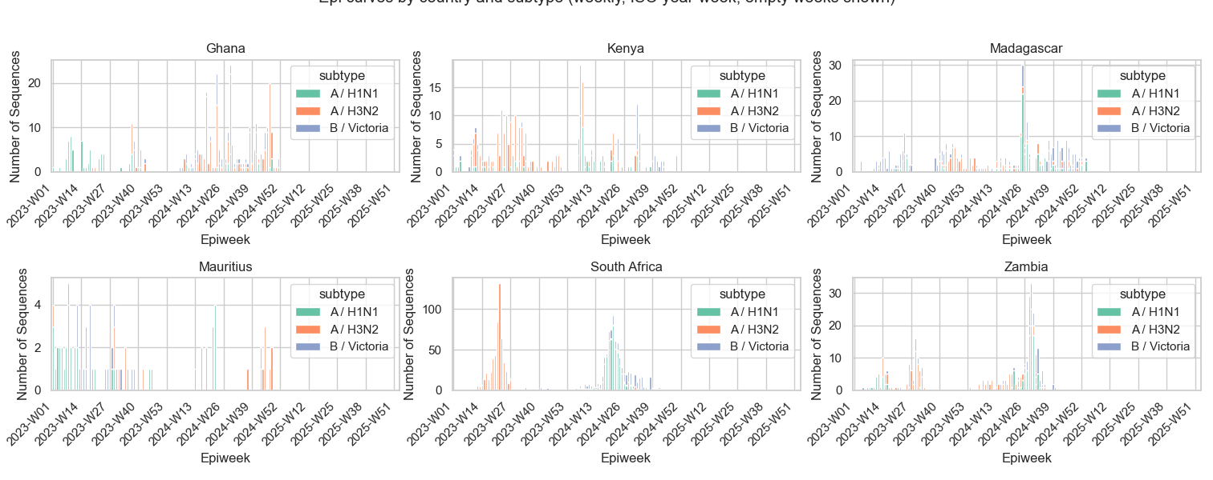
Subtype circulation in each country

Slide 8
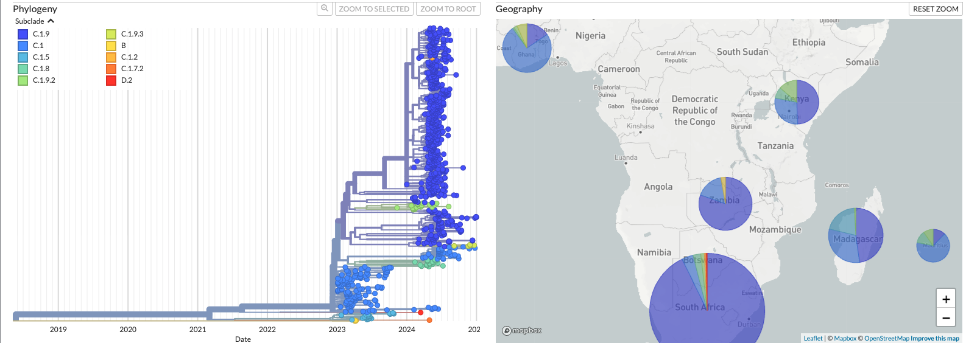
Phylogenetic analysis-H1N1
Between 2023 and 2024, a total of 23 unique influenza A subclades (10 H1N1 and 13 H3N2) were detected across surveillance data from the five African countries.

Slide 9
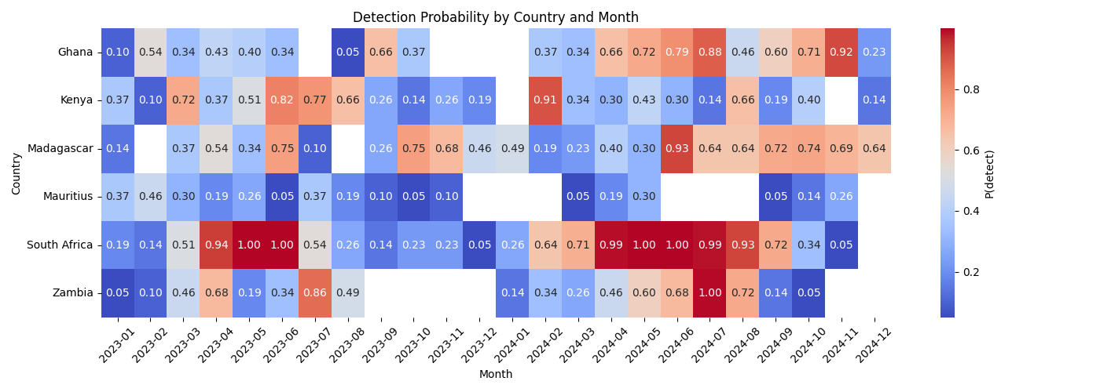
Figure: Monthly binomial detection probability for circulating influenza by country (2023–2024).
The minimum sample size for reliable detection was 59 influenza sequences per month (~15 per week).
Most countries achieved >50% detection probability during influenza season had intermittent periods of underpowered surveillance.
Notes:
Most countries achieved >50% detection probability during influenza season, especially in 2024 and had intermittent periods of underpowered surveillance, particularly during months of low influenza circulation.

Slide 10
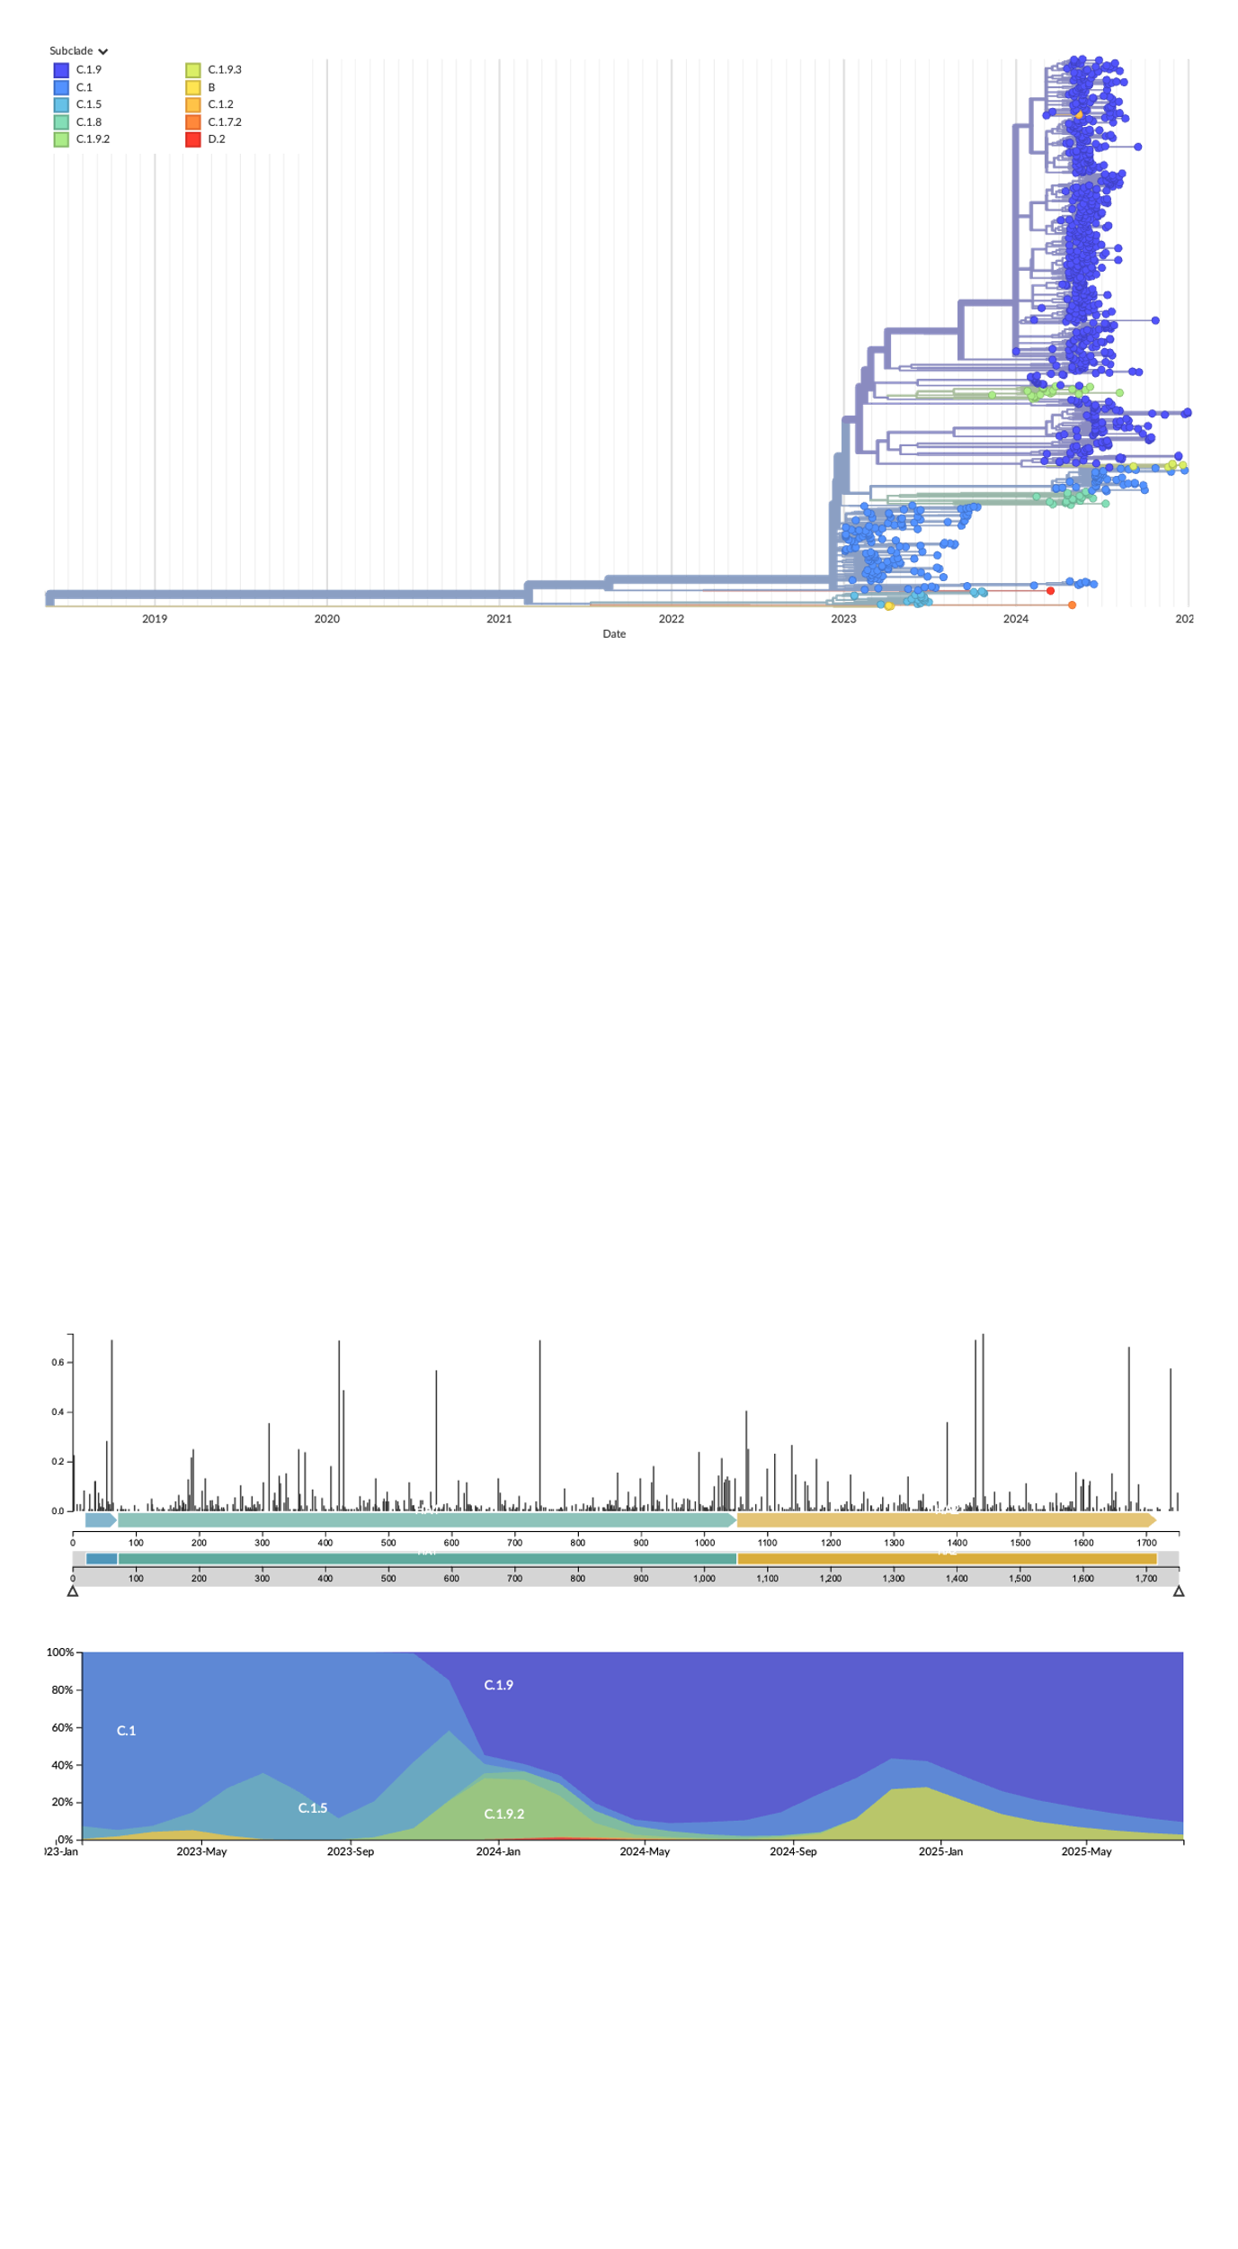
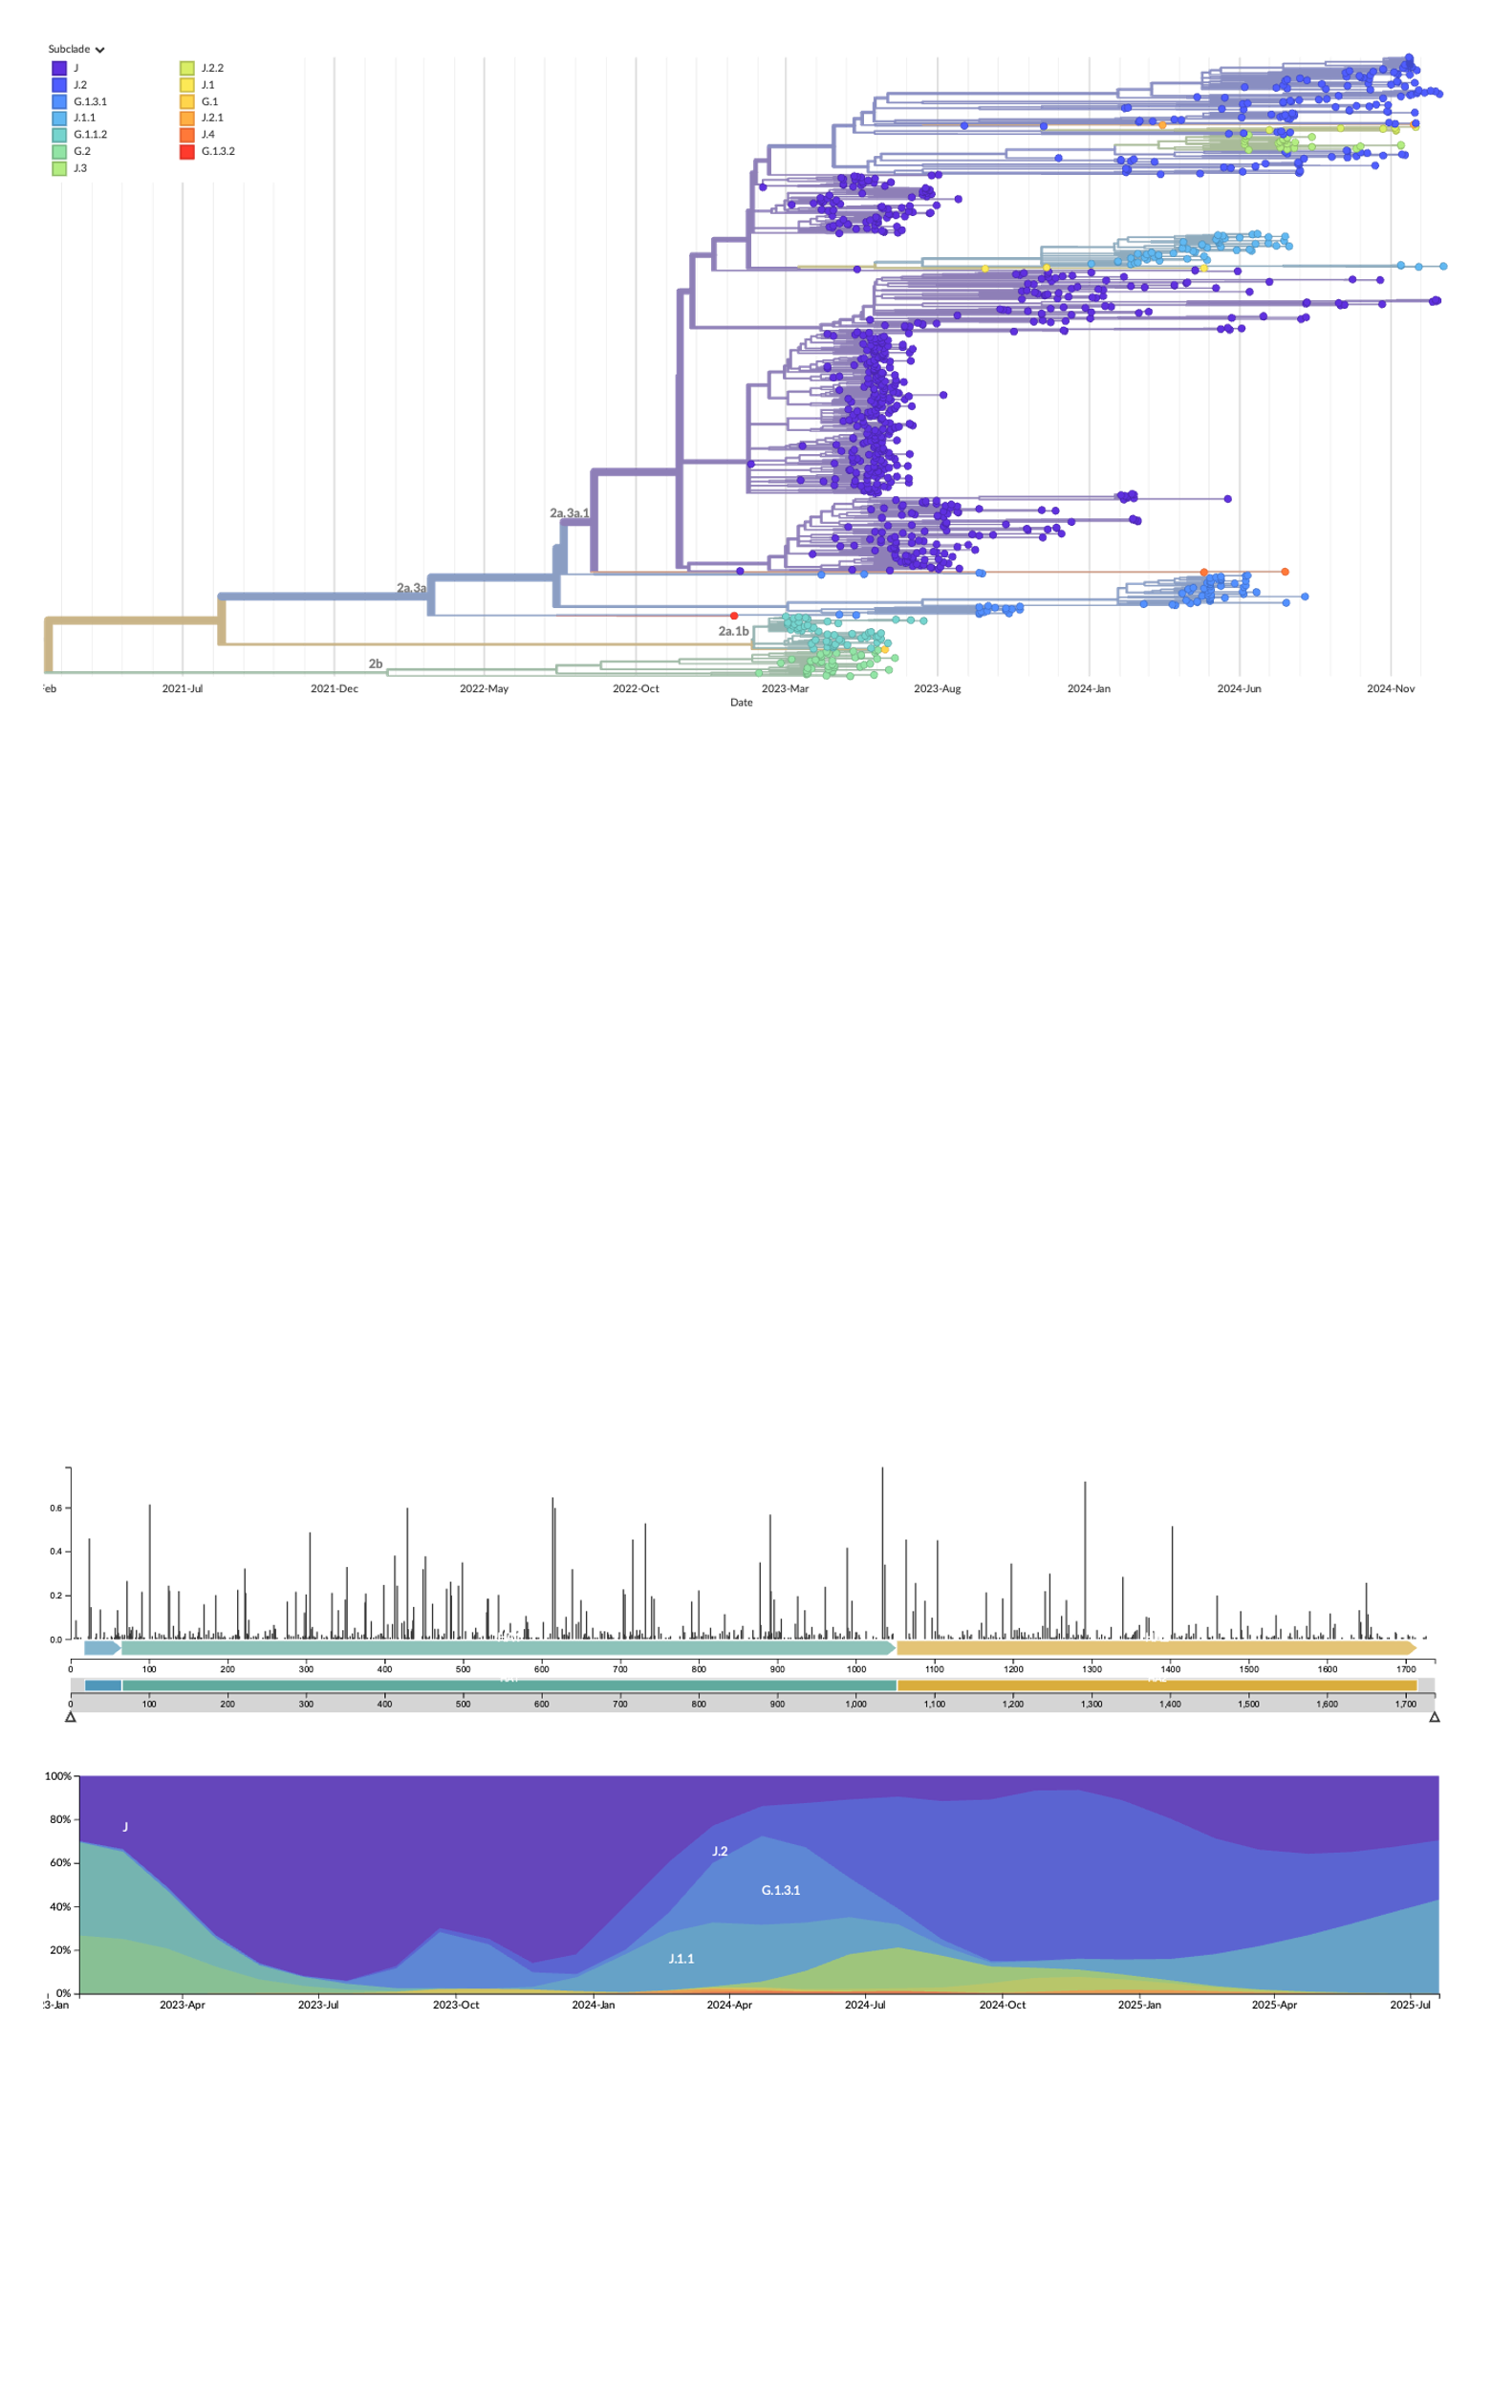
Figure: Time series of subclades detected over the two years in all five countries.
H1N1
H3N2
Subclade prevalence ranged annually from 0.13% to 78.9%
Notes:
with each country detecting at least 6 subclades at <5% prevalence.

Slide 11
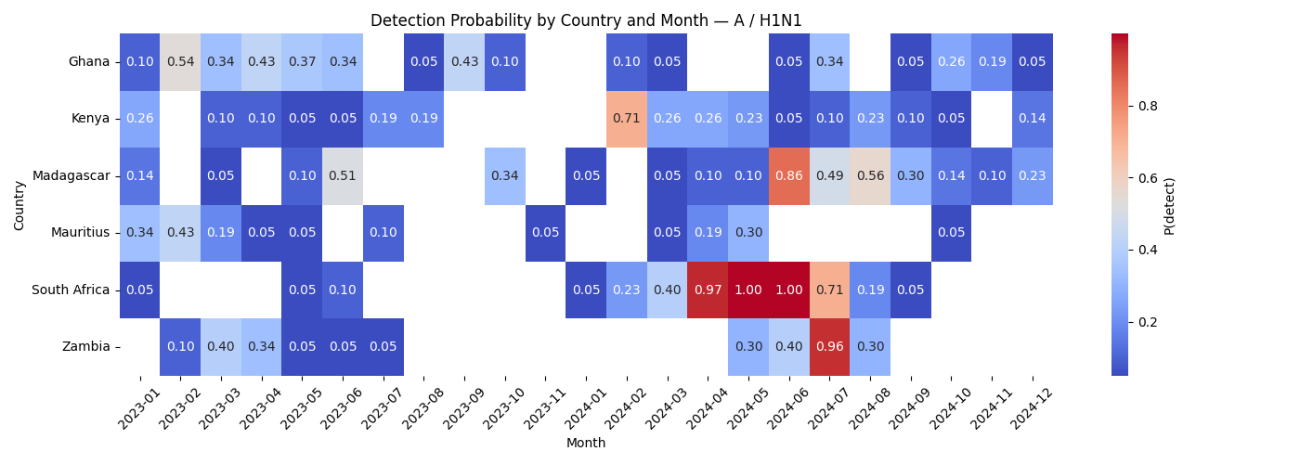
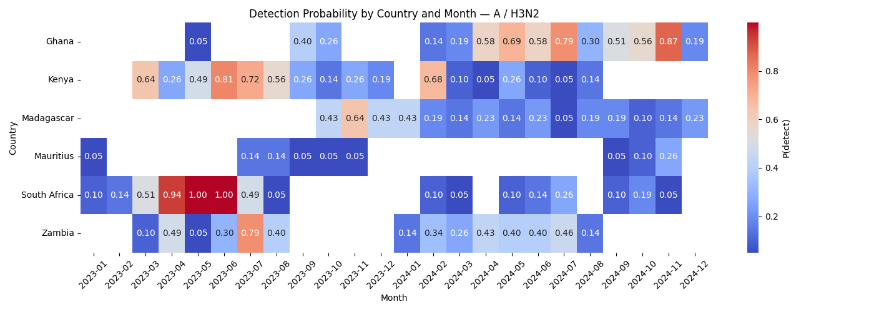
Figure: Monthly binomial detection probability for circulating Subtypes by country (2023–2024).
Low-prevalence subclades were detected in weeks where weekly sequencing totals were <15 (76.9%)
Notes:
Low-prevalence subclades were detected in weeks where weekly sequencing totals ranged from 1 to 86 sequences
We are defining low prevalence subclades according to their prevalence within out dataset and not necessarily subclades that are in low circulation globally

Slide 12
Work going forward (From your comments)
Analysis
Detailed molecular epidemiology of subclades circulating, finding commonalities between the regions.
Phylogeographic linking to track movement of subclades.
Bayesian trees to show genetic clustering of low prevalent subclades by country
Time-scaled trees overlaid with metadata to understand introductions vs persistence.
Writing
Protocol
Manuscript

Slide 13
Conclusions
Low-prevalence subclades (<5%) were consistently detected across all six countries, highlighting persistent cryptic circulation of rare influenza A variants.
South Africa, Madagascar, and Mauritius had the highest number of low-prevalence detections, largely due to higher sequencing coverage.
Over 47% of low-prevalence subclades were detected during weeks with <15 sequences, below the minimum threshold required to detect 5% prevalence with 95% confidence.
Country-specific subclade distributions showed both shared and distinct patterns, indicating heterogeneity in regional viral dynamics.
Weekly sequencing below 15 samples risks underrepresenting variant diversity, while >15 improves detection power considerably.
These findings support the implementation of right-sized genomic surveillance, adapted to seasonality, diversity, and detection confidence goals.

Slide 15
The end

Slide 17
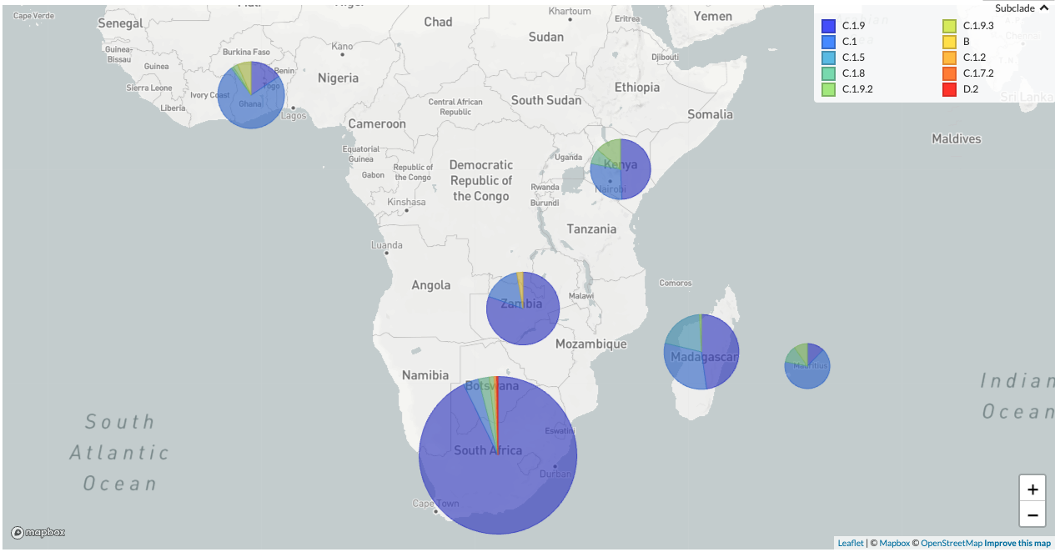

Slide 21
